Slide 1
Human visual system
prototype development
Dmitry Salikhov, Akbar Murataliev

Slide 2
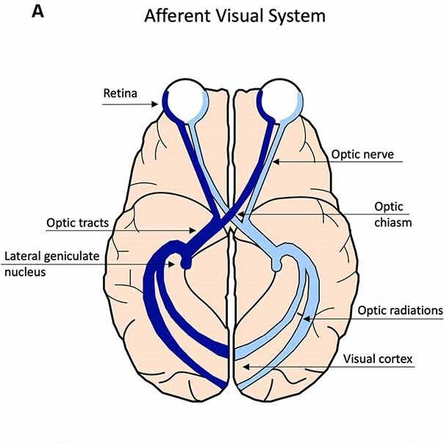
Human visual system
Retina
Optic nerve
Optic chiasma
Optic tract
Lateral geniculate nucleus
Optic radiation
Visual cortex

Slide 3
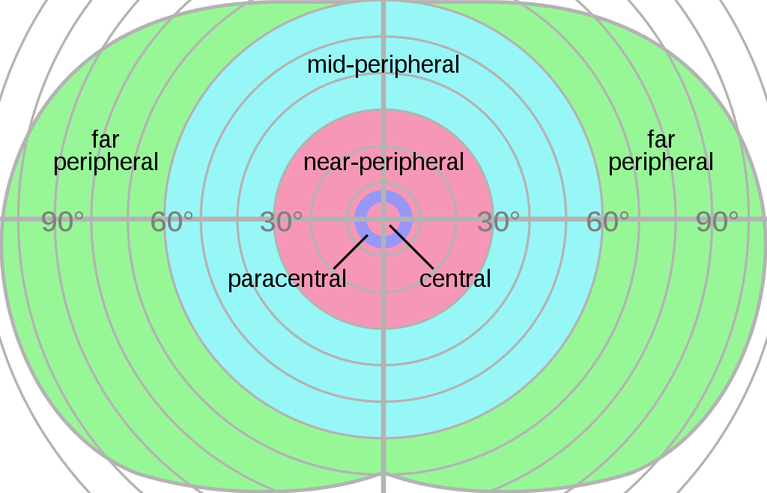
Field of view

Slide 4
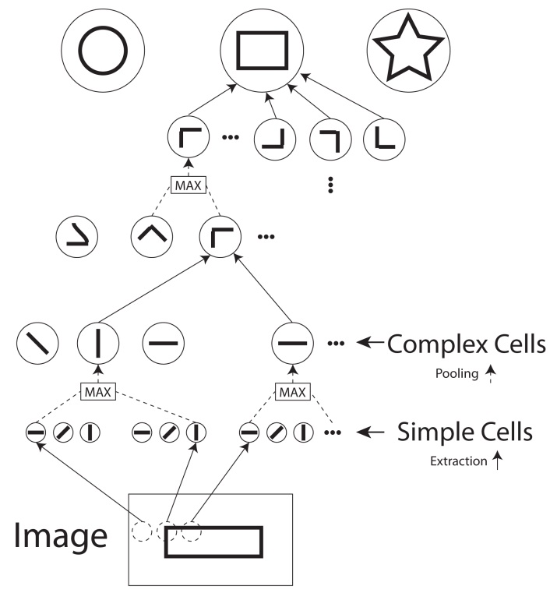
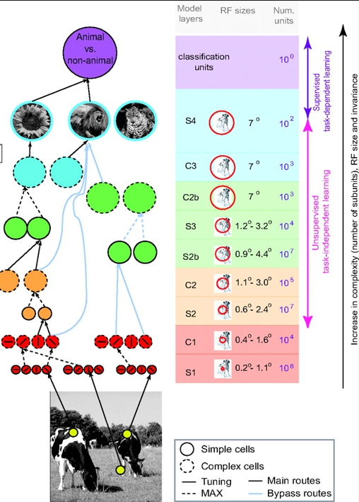
Optic primitives and patterns

Slide 5
Development plan
Creating objects and environment
Identifying regions of interest (ROIs)
Collecting geometric data
Primitives identification
Pattern creation
Pattern recognition

Slide 6
1. Creating objects and environment
We use Pygame and Box2D libraries
Environment is created using the Pygame
Objects are created using the Box2D
Objects are two-dimensional, have weight and other physical characteristics
For example, 2 triangles of different shapes are created in the diploma

Slide 7
2. Identifying regions of interest (ROIs)
We use NumPy, SymPy and Shapely libraries
We grab the object contour as an array of segments and polygonize it, reducing the dimension
We collect the coordinates of all points, the coordinates of segments and the lengths of all segments
We determine the threshold length of the segment separating short and long segments
We collect groups of short segments connected to each other - these are our ROIs
Calculate the center of ROI for each group of connected segments (by searching for midpoint for each segment)

Slide 8
3. Collecting geometric data
We use NumPy, SymPy and Shapely libraries
Expanding the field of observation
Divide the field into four quadrants
We extract the lengths of the segments squared
We extract the values of the angles squared
We determine how "loaded" the square is with segments, i.e. how many objects there are in it

Slide 9
4. Primitives identification
Creating a receptive layer
We categorize the data by the magnitude of the angle, the quadrant number and the ROI number
We make a dense representation of this information, i.e. we index it through 96 binary cells (8 categories of angles * 4 quadrants * 3 ROI)
For example, if there is a segment at an angle of 30 degrees in the first quadrant of the first ROI, cell one changes from 0 to 1
Cell numbers with a unit inside form a dense representation that characterizes the presence of primitives in the ROI
A dense representation is a formed pattern of the first level
Check if there is an identical pattern, if not, then add it to the list of ”remembered" patterns

Slide 10
5. Pattern creation
Creating 2 coding layers
By the connections between the layers, information about the pattern is transmitted to the coding layers
The first layer translates the dense representation into sparse (Sparsed Distributed Memory), the second from sparse to sparse
The translation is carried out using the SDR Processor file
The indices of activated neurons form the second code (1000 neurons in total)
If we have enough neurons activated (in accordance with the activation rate of 2%), then the pattern is fixed in deeper layers

Slide 11
6. Pattern recognition
After fixing the pattern, the area can "compare" the patterns with each other
Both the size and the unique content of the patterns are compared
Based on the value of the "similarity threshold", the region can tell us that the patterns are similar or not
The similarity threshold for the first layer is 0.9, the second layer is 0.4

Slide 12
How it works
Two objects are created
The ROI of the first object are identified
Geometric data about the first object is collected
The presence of primitives in the data is evaluated
A pattern is formed from the identified primitives
The pattern is passed through 2 coding layers
The second object is analyzed in the same way
Patterns are compared
The system determines whether the objects are similar and how much

Slide 13
What’s next?
Agent's "hand”
Interaction of the "hand" with objects
Independent exploration
Dopamine ”curiosity"
Text data entry
New layers of abstraction
Complex forms
Color Detection

